Slide 1
Global Semiconductor MI
Corporate Research Desk
July, 2012

Slide 2

Global Semiconductor MI
Market Overview
Competitive Landscape
Contract Analysis
Business Trends
Technology Trends
Market Drivers
Top 3 Market Players
Disclaimer:
The information presented in this report is based on data available in the public domain. If you find that it is incorrect, please let us know.

Slide 3
Global Semiconductor MI
Market Overview
Global Semiconductors & Semiconductor Equipment
Competitive Landscape
Global Semiconductor Equipment
Contract Analysis
Current Industry Trend
Expert Speaks
Business Trends
Industry Value Chain
Technology Trends
Market Drivers
Top 3 Market Players
Disclaimer:
The information presented in this report is based on data available in the public domain. If you find that it is incorrect, please let us know.

Slide 4
Global Semiconductor MI: Market Scenario Global Semiconductors & Semiconductor Equipment
Market Value
Semiconductor market - revenue accrued from the manufacture and sale of semiconductor devices, both integrated (IC) and discrete, and related products
Semiconductor equipment market - revenues accrued from the manufacture and sale of equipment for the production of semiconductor devices, including both wafer fabrication and packaging and assembly
The global semiconductors & semiconductor equipment industry had total revenues of $422.2 billion in 2011, representing a CAGR of 2.2% between 2007 and 2011
Global semiconductors & semiconductor equipment industry value: $ billion, 2007–11
The global semiconductors & semiconductor equipment industry experienced significant decline in 2008 and 2009, before recovering with very strong growth in 2010 followed by moderate growth in 2011. The industry is expected to continue to grow over the forecast period to 2016.
$ billion
% growth
Global computer hardware market value: $ billion, 2007–11(e)
Year | $ billion | % Growth
2007 | 387.4
2008 | 356.0 | -8.10%
2009 | 300.0 | -15.70%
2010 | 404.3 | 34.80%
2011 (e) | 422.2 | 4.40%
CAGR: 2007-11 |  | 2.2%
Year
Notes:
MarketLine Industry Profile - Global Semiconductors & Semiconductor Equipment (May 2012)

Slide 5
Global Semiconductor MI: Market Scenario Global Semiconductors & Semiconductor Equipment
Market Share
Global semiconductors & semiconductor equipment industry category segmentation: % share, by value, 2011
Semiconductors is the largest segment of the global semiconductors & semiconductor equipment industry, accounting for 90.1% of the industry's total value
The semiconductors segment contributed revenue of $380.4 billion in 2011
Category | 2011 ($ billion ) | %
Semiconductors | 380.4 | 90.1%
Semiconductor Equipment | 41.8 | 9.9%
Global semiconductors & semiconductor equipment industry geography segmentation: % share, by value, 2011
Asia-Pacific accounts for 67.1% of the global semiconductors & semiconductor equipment industry value.
Americas accounts for a further 17.4% of the global industry.
Category | 2011 ($ billion ) | %
Asia- Pacific | 283.2 | 67.1%
Americas | 73.5 | 17.4%
Europe | 47.5 | 11.2%
ROW | 18.1 | 4.3%
Notes:
MarketLine Industry Profile - Global Semiconductors & Semiconductor Equipment (May 2012)

Slide 6
Global Semiconductor MI: Market Scenario Global Semiconductors & Semiconductor Equipment
Forecast
Global semiconductors & semiconductor equipment industry value forecast: $ billion, 2011–16
Year | $ billion | % Growth
2011 | 422.2 | 4.4%
2012 | 434.7 | 3.0%
2013 | 455.4 | 4.8%
2014 | 484.2 | 6.3%
2015 | 518.9 | 7.2%
2016 | 549.9 | 6.0%
CAGR: 2011–16 |  | 5.4%
$ billion (e)
% growth
Year
In 2016, the global semiconductors & semiconductor equipment industry is forecast to have a value of $549.9 billion, an increase of 30.2% since 2011.
The industry is expected to see highest growth in the year of 2015
Notes:
MarketLine Industry Profile - Global Semiconductors & Semiconductor Equipment (May 2012)

Slide 7
Global Semiconductor MI: Market Scenario Global Semiconductor Equipment
Market Value
The global semiconductor equipment market is valued as the revenues accrued from the manufacture and sale of equipment used to manufacture semiconductor devices.
The market is divided into wafer fabrication equipment, assembly and packaging equipment, test equipment, and other equipment (including photomask and reticule production)
The global semiconductor equipment industry had total revenues of $41.8 billion in 2011, representing a CAGR of -0.6% between 2007 and 2011
Global semiconductors & semiconductor equipment industry value: $ billion, 2007–11
The global semiconductors & semiconductor equipment industry experienced significant decline in 2008 and 2009, before recovering with very strong growth in 2010 followed by moderate growth in 2011.
$ billion
% growth
Global computer hardware market value: $ billion, 2007–11(e)
Year | $ billion | % Growth
2007 | 42.8
2008 | 30.9 | -27.70%
2009 | 15.9 | -48.50%
2010 | 40 | 151.20%
2011 (e) | 41.8 | 4.50%
CAGR: 2007-11 |  | -0.6%
Year
Notes:
MarketLine Industry Profile - Global Semiconductor Equipment (May 2012)

Slide 8
Global Semiconductor MI: Market Scenario Global Semiconductor Equipment
Market Share
Global semiconductors & semiconductor equipment industry category segmentation: % share, by value, 2011
Wafer processing is the largest segment of the global semiconductor equipment market, accounting for 79.2% of the market's total value.
The Test segment accounts for a further 8.8% of the market.
Category | 2011 ($ billion ) | %
Wafer processing | 33.1 | 79.2%
Test | 3.7 | 8.8%
Assembly & packaging | 3.0 | 7.2%
Other | 2.0 | 4.8%
Global semiconductors & semiconductor equipment industry geography segmentation: % share, by value, 2011
Asia-Pacific accounts for 70.2% of the global semiconductor equipment market value.
Americas accounts for a further 14.4% of the global market.
Category | 2011 ($ billion ) | %
Asia- Pacific | 29.3 | 70.2%
Americas | 6.0 | 14.4%
Europe | 2.4 | 5.9%
ROW | 4.0 | 9.6%
Notes:
MarketLine Industry Profile - Global Semiconductor Equipment (May 2012)

Slide 9
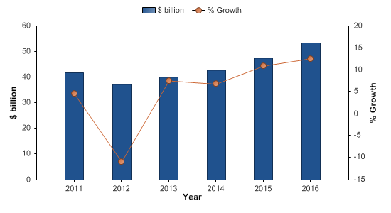
Global Semiconductor MI: Market Scenario Global Semiconductor Equipment
Forecast
Global semiconductors & semiconductor equipment industry value forecast: $ billion, 2011–16
Year | $ billion | % Growth
2011 | 41.8 | 4.5%
2012 | 37.3 | -10.9%
2013 | 40.1 | 7.5%
2014 | 42.8 | 6.8%
2015 | 47.4 | 10.9%
2016 | 53.4 | 12.6%
CAGR: 2011–16 |  | 5.0%
In 2016, the global semiconductor equipment industry is forecast to have a value of $53.4 billion, an increase of 27.7% since 2011.
The industry is expected to see highest growth in the year of 2016
Notes:
MarketLine Industry Profile - Global Semiconductor Equipment (May 2012)

Slide 10
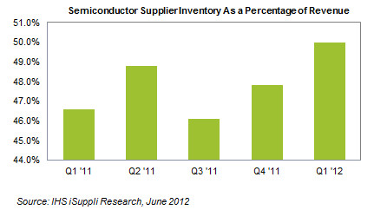
Global Semiconductor MI: Market Scenario Current Industry Trend
Worldwide sales of semiconductors reached $24.1 billion for the month of April 2012, a 3.4% increase from March 2012 when sales were $23.3 billion. This marks the largest month-over-month growth for the industry since May 2010
Increasing Demand in recent years
Semiconductor stockpiles held by chip suppliers increased during the first quarter of 2012, but the rise in inventory for a second straight quarter was driven by the anticipation of higher demand from customers
A look at customer inventory trends in the fourth quarter of 2011 reveals a broad-based decrease in stockpiles among major semiconductor purchasers.
Customer inventory trend –
Electronics distributor segment fell to 36.9% of revenue in the fourth quarter, down from 41.7% in the third quarter.
EMS providers- 24.9% down from 26.7%
Original equipment manufacturers in the storage segment- 20.8% down from 21.5%
Handset makers- 9.6% down from 13.8%
Notes:
Sources:
http://www.sia-online.org/news/2012/06/05/global-sales-report-2012/global-semiconductor-sales-grow-at-fastest-rate-in-almost-two-years-on-sequential-monthly-basis-top-24-billion-for-first-time-in-2012/

Slide 11
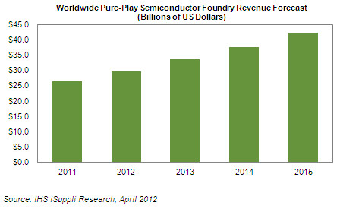
Global Semiconductor MI: Market Scenario Current Industry Trend
Pure-Play Semiconductor Foundry Market Growth
This year, the slowing sales of dynamic random access memory (DRAM)—a former revenue and technology leader within the broader memory segment—is forecast to underperform, especially in light of the recent bankruptcy filed by key DRAM player Elpida Memory Inc. of Japan.
Challenges- 1. The global economic crisis, 2. Inventory being a key issue- as companies are planning to place the orders at the last moment knowing that the foundries have excess capacity, 3. continuing decline in average selling prices (ASP) in light of increased overall competition.
Foundries are manufacturers that produce semiconductors for fabless firms, i.e., companies that don’t operate their own semiconductor-manufacturing facilities.
Revenue in 2012 for pure-play foundry suppliers is forecast to grow to $29.6 billion, up a brisk 12 percent from $26.5 billion in 2011
Increasing electronics content in popular tablet and smartphone devices like the iPad and iPhone and in Ultrabook PCs will drive accelerated growth for the global semiconductor foundry business
In particular, the increased sales expected this year in tablets and smartphones will spur revenue expansion for the NAND flash memory and logic application-specific integrated circuit (ASIC) semiconductor markets.
Rank | Company | Revenue in 2011 ($ billion)
1 | Taiwan Semiconductor Manufacturing Corp | 14.0
2 | UMC | 3.6
3 | GLOBALFOUNDRIES | 3.5
4 | Semiconductor Manufacturing International Corp | 1.3
5 | TowerJazz Semiconductor | 0.61
Notes:
Sources:
http://www.isuppli.com/Semiconductor-Value-Chain/News/Pages/Pure-Play-Semiconductor-Foundry-Market-Set-for-12-Percent-Growth-in-2012.aspx

Slide 12
Global Semiconductor MI: Market Scenario Expert Speaks
“
The outlook for the global semiconductor industry continues to be one of cautious optimism. We are beginning to see an encouraging trend of modest, sequential growth and we anticipate this trend will continue during the rest of this year, with stronger growth predicted for 2013 and beyond. But that optimism continues to be tempered by macroeconomic factors
”
Brian Toohey
president & CEO, Semiconductor Industry Association
“
In the fourth quarter, inventory rose among suppliers because of uncertain macroeconomic conditions such as the sovereign debt crisis in Europe, leading to an overall decline in the worldwide demand for semiconductors. And while inventory rose during the fourth quarter for semiconductor suppliers, chip stockpiles fell at the same time among customers, indicating a paucity in demand. In contrast, the higher inventory numbers among semiconductor suppliers for the first quarter of 2012 represent a signal of better things to come. There was an increasing level of inventory both among chip suppliers and customers, indicating that both the supply and demand sides of the business believe that the environment in the electronics market has turned positive.
”
Sharon Stiefel
semiconductor inventory analyst at IHS
Notes:
Sources:
http://www.sia-online.org/news/2012/06/05/global-sales-report-2012/global-semiconductor-sales-grow-at-fastest-rate-in-almost-two-years-on-sequential-monthly-basis-top-24-billion-for-first-time-in-2012/

Slide 13
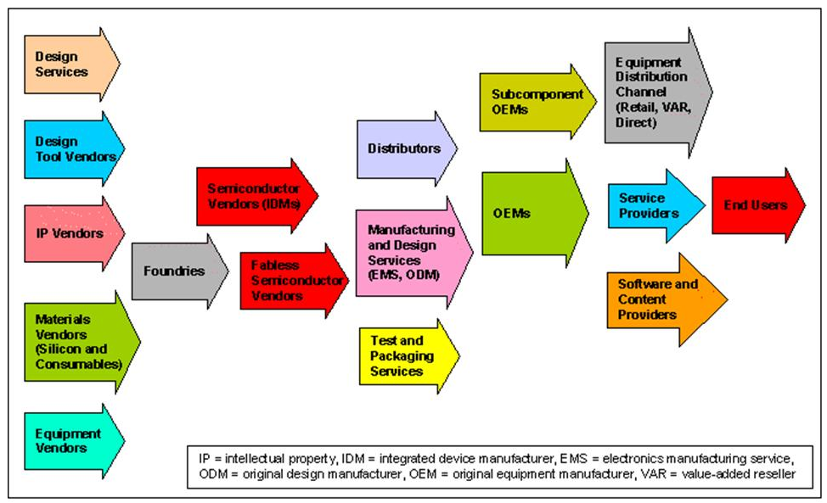
Global Semiconductor MI: Market Overview Semiconductor Industry Value Chain
Participants in the Semiconductor Industry Value Chain

Slide 14
Global Semiconductor MI
Market Overview
Porter’s 5 Forces Analysis
Competitive Landscape
Top 20 Companies by Yearly Sales
Contract Analysis
Business Trends
Technology Trends
Market Drivers
Top 3 Market Players
Disclaimer:
The information presented in this report is based on data available in the public domain. If you find that it is incorrect, please let us know.

Slide 15
Global Semiconductor MI: Competitive Landscape Porter’s 5 Forces Analysis
Rivalry
• Players in US semiconductor market range in size from medium to large, and are rare as sophisticated know-how is required.
• Switching costs for end-users vary according to the type of semiconductor in question.
Supplier Power
• Fabrication plant requires significant initial investment.
• Suppliers are manufacturers of equipment for fabs, and manufacturers of ultrapure semiconductor wafers; such companies are rare increasing supplier power.
• Switching costs include risk of sourcing raw materials of inadequate quality and interruptions in the supply chain.
• Less likelihood of vertical integration between semiconductor manufacturers and their suppliers.
New Entrants
• High entry barriers due to the level of investment required.
• Fabless manufacturing offers a lower cost route.
• High level of R&D required.
Buyer Power
• Buyers include makers of electronic products: computer & network hardware, defense systems, industrial controls, vehicles and consumer electronics.
• Semiconductors are found in wide range of products, making the number of potential customers high.
• Strong product differentiation.
• Scope of vertical integration: for e.g. companies like Samsung make both electronic products and semiconductor devices.
Threat of Substitutes
• No significant alternatives to semiconductors.
• Semiconductor devices are usually very successful substitutes for older technologies.
• ‘Bottom up‘ fabrication using nanotechnology may offer devices with superior characteristics to conventional semiconductors in the long term.
Notes:
Sources:
Datamonitor

Slide 16
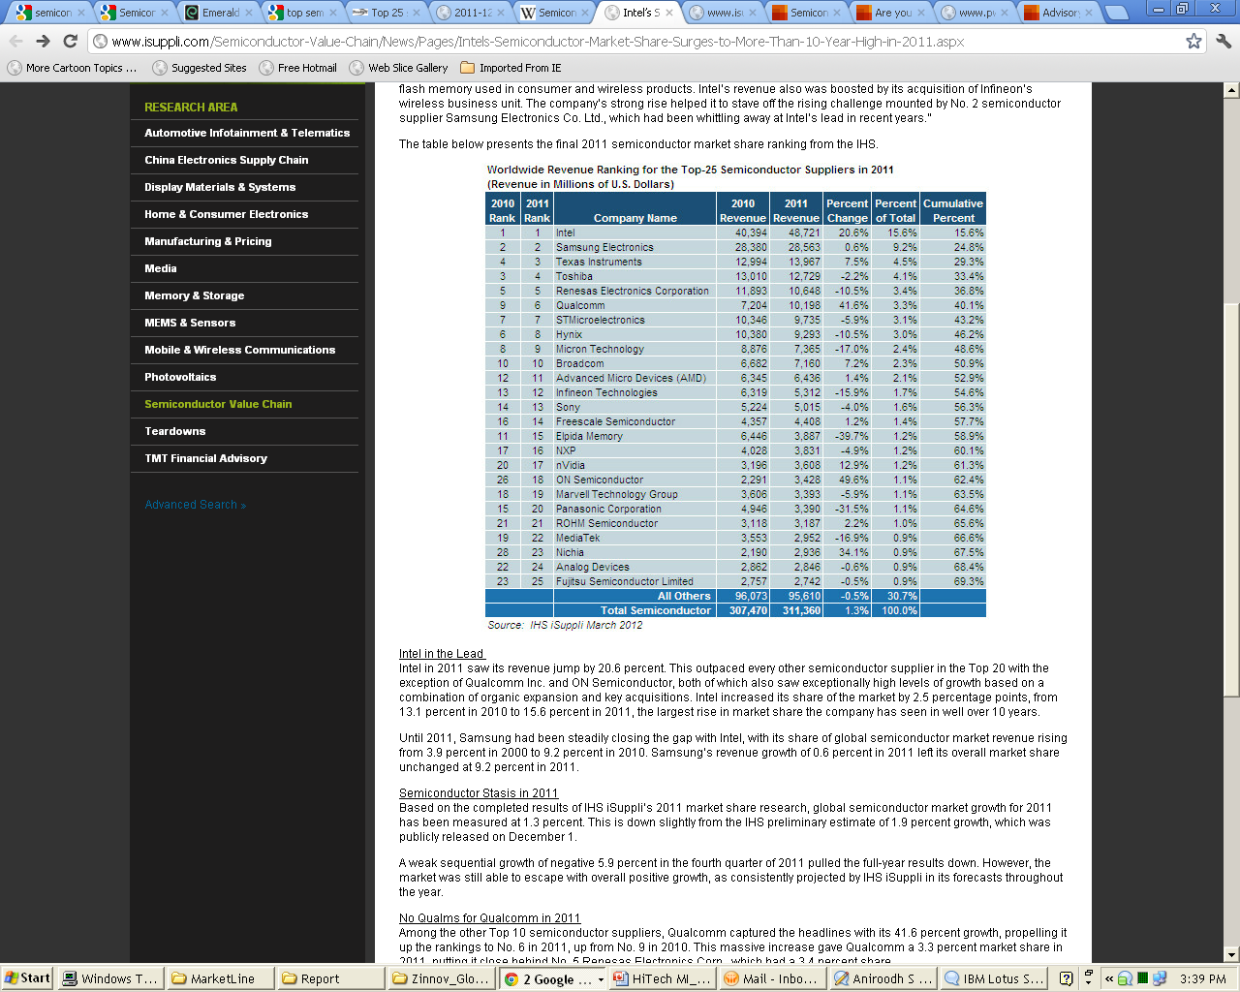
Global Semiconductor MI: Competitive Landscape Top 20 Companies by Yearly Sales
Important M&A in industry- 2011
Intel Corporation acquisition of Infineon Technologies wireless division.
Texas Instruments acquisition of National Semiconductor.
Qualcomm acquisition of Atheros Communications.
ON Semiconductor acquisition of Sanyo semiconductor division.
Important M&A in industry- 2010
Renesas Electronics was formed by the merger of Renesas Technology and NEC Semiconductors.
Micron Technology acquisition of Numonyx.
Note: The ranking is based on the definition of the industry by iSuppli. Some of the companies will fall under Electronics segment as per TCS definition of Hi Tech Industry
Notes:
Sources:
Wikipedia
iSuppli Corporation supplied rankings for 2011

Slide 17
Global Semiconductor MI
Market Overview
Competitive Landscape
Trends
Contract Analysis
Important Deals
Business Trends
Technology Trends
Market Drivers
Top 3 Market Players
Disclaimer:
The information presented in this report is based on data available in the public domain. If you find that it is incorrect, please let us know.

Slide 18
Global Semiconductor MI: Contract Analysis Trends
Year wise Contract Value Range distribution
The deals signed are mostly below $ 20 million
The number of contracts signed during the 2007-2009 period was highest . This was mainly to improve the process utilization and due to the cost cutting attempt
Note: Analysis is done on the contracts signed between 2006 to 2011. The list is compiled from IDC database hence it could be non exhaustive
Notes:
Source:
IDC

Slide 19
Global Semiconductor MI: Contract Analysis Trends
Year wise number of Contracts
Year wise average value of Contracts
The number of contracts signed during the 2007-2009 period was highest . This was mainly to improve the process utilization and due to the cost cutting attempt
Highest average deal value was signed during the period 2008 as two of the top 5 costliest deal was signed in this year
Note: Analysis is done on the contracts signed between 2006 to 2011. The list is compiled from IDC database hence it could be non exhaustive
Notes:
Source:
IDC

Slide 20
Global Semiconductor MI: Contract Analysis Trends
Number of Contracts based on pricing methodology
Average Contract Value (in $ million) based on pricing methodology
The Pricing methodology adopted is primarily Fixed Price.
Unlike other industry the Fixed Price deals have higher average value than the Combination price deals
Note: Analysis is done on the contracts signed between 2006 to 2011. The list is compiled from IDC database hence it could be non exhaustive
Notes:
Source:
IDC

Slide 21
Global Semiconductor MI: Contract Analysis Trends
Year wise Number of contracts as per Engagement Type
Engagement Type wise Average Contract Value
Average Deal Value ($ million)
IT outsourcing engagement is the prevalent engagement type with highest average deal value
Note: Analysis is done on the contracts signed between 2006 to 2011. The list is compiled from IDC database hence it could be non exhaustive
Notes:
Source:
IDC

Slide 22
Global Semiconductor MI: Deals Important Deals
Deals Expired in 2011
Deals Expiring in 2012
Deals Expiring in 2013
Contract list Till date
Notes:
Source:
IDC

Slide 23
Global Semiconductor MI
Market Overview
Competitive Landscape
Changing Business Model
Contract Analysis
Consolidate or Diverge
Business Trends
Going Green
Technology Trends
Original Brand Marketer
Market Drivers
Growth Cycle
Top 3 Market Players
Rising R&D Costs
Disclaimer:
The information presented in this report is based on data available in the public domain. If you find that it is incorrect, please let us know.

Slide 24

Global Semiconductor MI: Trends Business Trends : Changing Business Model
After the Global Semiconductor Industry fell in 2008 due to the economic crisis, and fortunately rebounded in 2009 as various semiconductor companies posted gains.
However, in 2010 many of these semiconductor firms shifted their business models from the department store model as many of the Japanese companies were making changes in the business decision making mode.
Structural reforms meant essentially goodbye to the department store business model and the withdrawal of the less competitive areas, while the more competitive products became the key business areas.
Fujitsu Microelectronics at the end of 2009, decided to reduce and freeze WiMAX base station chip 16-bit general-purpose micro-controller, digital TV Engine, portable equipment FCRAM memory, single-band modulator, 40nm silicon foundry business, along with six new product development.
Toshiba decided to withdraw from built-in processor core microcontroller / ASSP business and LCD driver business, and focus on the advanced silicon foundry business to expand.
Changing Business
Model
Texas Instruments acquired semiconductor company National Semiconductor for US$6.5 billion. TI, which makes low-power chips, would combine its 30,000 analog products and advanced manufacturing capabilities with the offerings of National Semiconductor, which makes analog integrated circuits.
NEC Electronics and Renesas Technology decided to integrate their business operations in 2009.
Fujitsu decided to outsource production of its most advanced semiconductors to TSMC of Taiwan, as a part of the restructuring efforts of Japan’s chip industry. The strategy meant a gradual exit from chip production for Fujitsu, which made a range of processor chips, because it will not replace facilities in Japan as they become obsolete.
The business models within the semiconductor industry will undergo change and this will continue to occupy management
at semiconductor manufacturers.
Notes:
Sources:
http://www.articlesbase.com/project-management-articles/semiconductors-changing-business-models-to-meet-the-post-silicon-era-the-semiconductor-silicon-era-after-the-electronics-industry-3295122.html#ixzz1Jxm3nE1W PWC Report: A change of pace in the semiconductor industry, November 2009
http://www2.renesas.com/news/en/archive/0904/2701.html
http://www.ft.com/cms/s/2/1391c66e-35e8-11de-a997-00144feabdc0.html#ixzz1JxpXBuwZ
http://www.cio.in/news/ti-buys-national-semiconductor-65-billion-103862011

Slide 25

Global Semiconductor MI: Trends Business Trends : Consolidate or Diverge?
The semiconductor and electronics industries have experienced large numbers of mergers, acquisitions, joint ventures, licensing deals and startups, funded from a number of sources.
Alliances are an essential means through which the industry will operate and grow. Many areas of funding would be impossible for individual companies to afford, but can be readily achieved collaboratively.
By 2015, collaborative R&D will save the semiconductor industry more than $30 billion in annual R&D expenditure. Semiconductor startup companies are also experiencing big shifts in funding and we have seen far fewer company formations over the past two to three years than previously.
The scale of funding is also changing, involving fewer but larger investments, which involve more risk and are often less attractive to venture capital companies.
Consolidate or Diverge?
Companies like Xilinx and Western Design Center were pioneers. They focused on being Fabless semiconductor company where a company could focus all its resources to the design, marketing, and sale of its devices while outsourcing the production of its devices to manufacturers called fabs.
Rock’s Law- Arthur Rock in which he proposes that the cost of a fabrication plant doubles every 4 years and eventually gets to the point in which it will collide with Moore’s law. The idea being if these plants effectively become too expensive to build, then Moore’s law cannot be met.
The solution is to collaborate between the companies
AMD spins off its fabrication business model into another entity and calls it Global Foundries.
TI and Infineon outsourcing some production to Shanghai's Semiconductor Manufacturing International Corporation.
Texas instruments divested more than 15 lower growth, lower margin business in the past 15 years (including DRAM and defense control units) to focus on wireless business
The trend as seen by experts, is that there will be an ongoing industry wide move towards collaboration. However, companies like Intel, IBM, and Toshiba – who are currently market leaders in the microprocessors, servers, and memory field (within that order) – will be able to survive on their own as they have market dominance and able to afford fabrication costs and expenses, but for how long is left to speculation.
Notes:
Sources:
PWC Report: A change of pace in the semiconductor industry, November 2009
http://en.wikipedia.org/wiki/Semiconductor_consolidation
http://en.wikipedia.org/wiki/Semiconductor_consolidation

Slide 26
Global Semiconductor MI: Trends Business Trends : Consolidate or Diverge?
Recent Mergers & Acquisitions in Semiconductor Industry
Acquiring Company | Acquired Company | Benefits | Status
Applied Materials | Varian Semiconductor | • Extend Applied’s leadership in chip equipment and better serve customers with chip complexity, transistor scaling and 3D challenges. • Critical for Applied’s circuit manufacturing, giving them a lead in wafer fabrication equipment (WFE) with the addition of the technology leader in ion implantation. • Varian's technology could also extend Applied’s presence into other markets, including solar, display and light emitting diodes. | Announced on May 2011
Texas Instruments | National Semiconductor | • TI will add 12,000 analogue products from National to its own 30,000-strong portfolio. • Combined companies will have a worldwide semiconductor manufacturing footprint and a salesforce of over 2,500 people • Acquisition will give TI a network of semiconductor fabs spread across at least eight countries. | Announced on April 2011
NEC Electronics | Renesas Technology | • Renesas Electronics Corporation was formed merging the two companies in 2009 helping both to cut costs by about $1 billion each in the wake of recession. | Completed on April 2010
Micron Technology | Numonyx | • With this acquisition, Micron builds on its position as one of the world's leading memory companies with increased scale, a broader product portfolio and industry-leading technology. • Transaction strengthens Micron's broad portfolio of DRAM, NAND and NOR memory products and strong expertise in developing and supporting memory system solutions. • Micron also gains increased manufacturing and revenue scale along with access to Numonyx's customer base, providing significant opportunities to increase multi-chip offerings in the embedded and mobile markets. | Completed on May 2011
Notes:
Sources:
Onesource
http://financial.tmcnet.com//topics/mergers-acquisitions/articles/170945-merger-news-applied-materials-acquire-varian-semiconductor.htm
http://www.zdnet.co.uk/news/mergers-and-acquisitions/2011/04/05/texas-instruments-to-buy-national-semiconductor-40092390/
http://www.microcontroller.com/news/Renesas_NEC_Merge.asp
http://news.micron.com/releasedetail.cfm?ReleaseID=467632

Slide 27

Global Semiconductor MI: Trends Business Trends : Going Green
As traditional energy sources, such as oil and gas, continue to rise in price because of supply constraints and ever - increasing demand, also there is growing concern over the environmental impact of these fossil fuel energy sources.
As a result, there is intense interest in renewable forms of energy generation. Governments in many parts of the world are promoting the adoption of renewable sources, notably solar energy.
There is also much interest in reducing energy consumption through different usage patterns, smarter energy management and more efficient appliances.
Enterprises are also being encouraged by a combination of pressure from customers and other stakeholders and government incentives.
“Going green” for an environmentally sound value chain and development of energy-saving components will continue to be relevant not only because of environmental awareness of consumers but also to control the costs of energy and disposal for electronics components and semiconductor manufacturers
Going Green: Reducing & managing energy consumption
Green Initiatives by Semiconductor Firms:
At Fairchild Semiconductor, the Green initiative is a customer driven program to promote the use of ‘green' material in supplier's products. Also, all products of Fairchild are compliant with RoHS and lead-free requirements, and meet environmental, health and safety
standards.
Texas Instruments embarked on an ambitious project to build the world’s first “green,” LEED-certified (Leadership in Energy and Environmental Design) semiconductor manufacturing facility in an effort to reduce construction and operating costs and the company’s impact on the environment.
Intel invests $10 million in green technology companies to reduce electricity bills and greenhouse gas emissions in homes and data centers.
3 of the Top 10 companies on the Forbes’ Top Green Companies 2010 List belong to the High Tech industry: Intel, Dell and Cisco.
Notes:
Sources:
PWC Report: A change of pace in the semiconductor industry, November 2009
Gartner Report - Predicts 2011: Semiconductor Industry Structure and Products Continue to Adapt
http://www.fairchildsemi.com/company/green/rohs_green.html
http://www.ti.com/corp/docs/rennerroadfab/gdoverview.shtml
http://www.infoworld.com/d/green-it/intel-invests-10-million-in-green-technology-companies-244
http://www.ranker.com/list/top-green-companies-2010/eco-warrior-chick

Slide 28

Global Semiconductor MI: Trends Business Trends : Growth of the "Original Brand Marketer – OBM"
In this supply model, a brand owner markets and sells the electronic equipment, but has little or no involvement in the electronics design, manufacturing or semiconductor purchasing. Examples include Gucci, Levi's and JCB, Verizon for mobile phones and Kodak and Polaroid for DSCs.
This model often involves designing a chip that is critical to the equipment (typically an application-specific integrated circuit or application-specific standard product) and managing its manufacture using semiconductor foundry services.
OBM model has become significant since some brand owners have better insight into consumer demand and because successful sales for consumer electronics is less to do with engineering abilities and more to do with aesthetics and consumer fashion.
OBM model relies on ODMs, EMS companies and electronics design houses to design and manufacture the hardware for the brand owner to sell. Semiconductor vendors with reference designs for electronic equipment have a significant advantage here.
Growth of the "Original Brand Marketer – OBM" model
OBM Model Examples:
Major EMS and ODM-orientated companies like Hon Hai are expanding by forging links directly with mobile operators to build operator-branded handsets.
They are also acquiring retail channel outlets in mainland China. This extends their vertical reach to retail sales and enables foreign brands to compete more directly with local Chinese brands in the high streets and shopping malls of China.
Companies with their strength mainly in their brand (and aesthetics) are proving they can compete with companies that have their strength mainly in their engineering.
Notes:
Sources:
PWC Report: A change of pace in the semiconductor industry, November 2009
Gartner Report - Predicts 2011: Semiconductor Industry Structure and Products Continue to Adapt
http://www.fairchildsemi.com/company/green/rohs_green.html
http://www.ti.com/corp/docs/rennerroadfab/gdoverview.shtml
http://www.infoworld.com/d/green-it/intel-invests-10-million-in-green-technology-companies-244
http://www.ranker.com/list/top-green-companies-2010/eco-warrior-chick

Slide 29
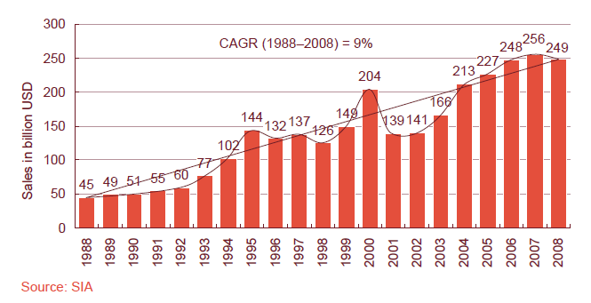

Global Semiconductor MI: Trends Business Trends : Growth Cycle
Growth Cycle
Historically the semiconductor industry has shown a strong cyclical behavior. During a typical upturn of one to two years most companies generate profits, which they use to sustain there operations during the downturn.
Many players use their strong performance during an upturn to entice investors in the public markets or get new loans to fund capital investments, many a times government subsidizes these.
But as the investment runs ahead of the market demand during the upturn, the period is followed by a longer downturn or very slow growth
Though the amplitude and time frame of the cyclicality is moderating, but it is likely that some cyclicality will always remain
Though the industry outlook seems to be positive at this moment, the industry trend indicates that a sluggish period will be followed and the Eurozone crisis may add to the woe
Notes:
Source-
Creating Value in the Semiconductor Industry- Mckinsey on Semiconductors 2011
A change of pace for the semiconductor industry – Pricewaterhouse Coopers report 2009

Slide 30
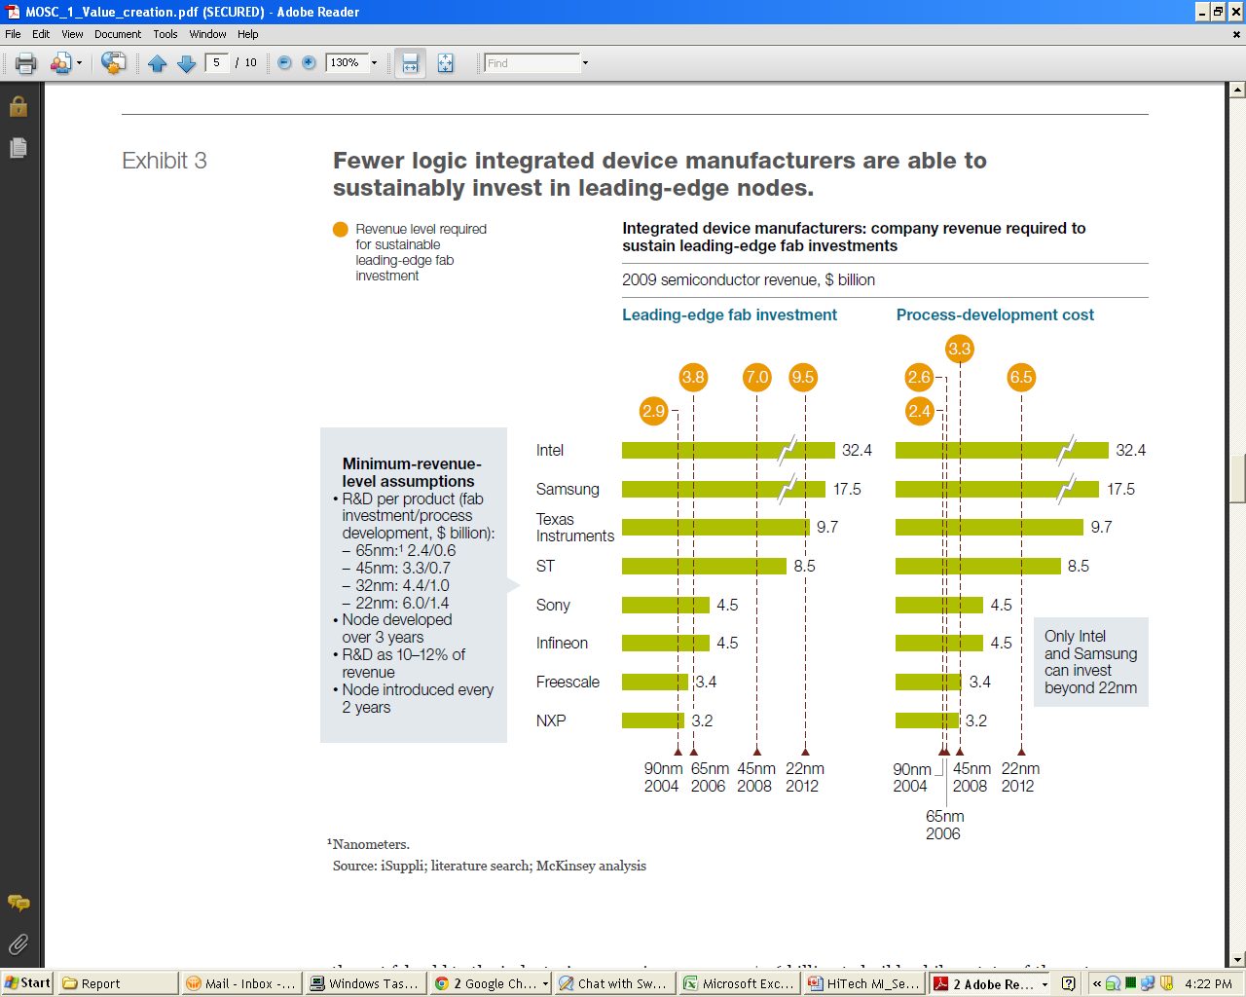

Global Semiconductor MI: Trends Business Trends : Rising R&D Costs
Rising R&D Costs
Revenue level required for sustainable leading edge fab investment
 | 2009 revenue ($ billion)
Chip makers continue to pour money into R&D as new designs and process technologies are becoming increasingly expensive to develop
In 2009, R&D expenditure was 17% of industry revenue as compared to 14% a decade earlier
The cost of building leading edge fabs continues to increase. Average 8-inch fab costs $ 1.6 billion to build as compared to 12- inch fab costing $3 billion to $4 billion.
The cost of developing process technologies on new nodes is increasing dramatically. Average cost of developing a 90-nm logic process technology is approximately $300 million, while the cost of developing a 45-nm logic process technology is approximately $600 million
The “fab lite” strategy has resulted in an overall net reduction of capital expenditure from an average of 27% of revenues (1996-2001) to 20% (2002-2009), but it has led to intense cost pressure to chip makers
In response to these higher costs, many semiconductor companies have resorted to “fab lite” strategy, outsourcing an increasing proportion of their chip production to dedicated foundries
Notes:
Source-
Creating Value in the Semiconductor Industry- Mckinsey on Semiconductors 2011

Slide 31
Global Semiconductor MI
Hype Cycle
Market Overview
Priority Matrix
Competitive Landscape
On The Rise
Contract Analysis
At The Peak
LED Technology
Business Trends
Many- Core Processors
Technology Trends
Cloud Adoption
Market Drivers
Automotive Semiconductor
Top 3 Market Players
DRAM and NAND Flash Memory
Solar Energy
System On Chip
Disclaimer:
The information presented in this report is based on data available in the public domain. If you find that it is incorrect, please let us know.

Slide 32
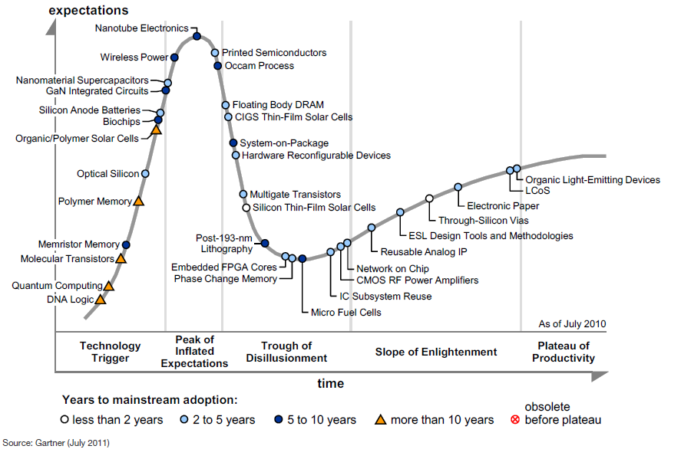
Global Semiconductor MI: Trends Technology Trends : Hype Cycle
Notes:
Sources:
Gartner- Hype Cycle for Semiconductors and Electronics Technologies, 2011 (Published: 25 July 2011)

Slide 33
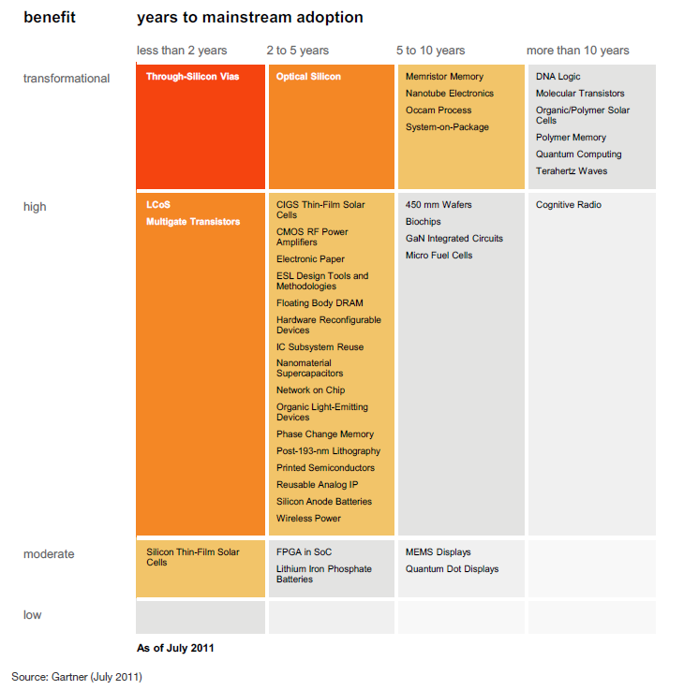
Global Semiconductor MI: Trends Technology Trends : Priority Matrix
Notes:
Sources:
Gartner- Hype Cycle for Semiconductors and Electronics Technologies, 2011 (Published: 25 July 2011)

Slide 34

Global Semiconductor MI: Trends Technology Trends : On The Rise
Developments in this topic have slowed during the past two-tothree years.
Early research has demonstrated the feasibility of DNA computation, but the challenges for further development are considerable.
Commercialization will require standards totally lacking in DNA computation for representing and encoding data, for example, inputting and outputting data.
There are also unanswered questions about the scalability and repeatability of computations over a range of temperatures and other variables.
In addition to these basic challenges, the technology will require a new hardware and software infrastructure, which is clearly a huge barrier to adoption.
DNA Logic
DNA molecular logic- logic. These are logic operations, based on the properties of DNA molecules for storage and processing (we are focusing on logic rather than storage). Logic functions are formed from the binding of DNA molecules in various combinations. For example, a DNA "AND“ gate would chemically join two separate DNA codes in an end-to-end string. Logical "OR" and other functions are also possible.
DNA-based biologic computing- This uses the properties of simple living organisms to respond to various stimuli, such as light, electric charge and pressure. The organisms may be purely biological or a living silicon hybrid. This form of computing raises significant ethical issues that will impact on the timing and direction of future development
Potential for very high computing performance — within a small physical space and with extremely low energy requirements.
Gartner Rating- Benefit Rating: Transformational; Market Penetration: Less than 1% of target audience
Notes:
Sources:
Gartner- Hype Cycle for Semiconductors and Electronics Technologies, 2011 (Published: 25 July 2011)

Slide 35
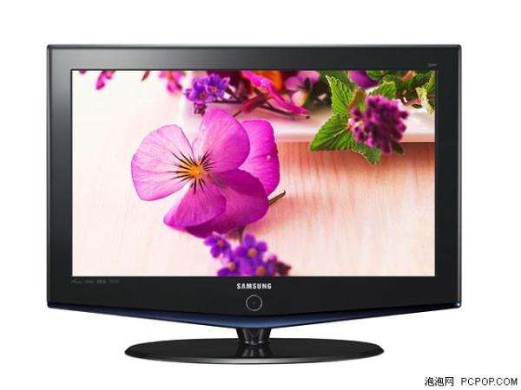
Global Semiconductor MI: Trends Technology Trends : On The Rise
Displays are an essential part of the user experience for mobile devices and smartphones. As video, Web browsing, gaming and navigation applications become more sophisticated on mobile phones, display performance considerations play a key role, especially related to the high demands they place on the battery.
Quantum-dot-based displays promise key advantages over existing display technologies (such as LCDs and OLEDs), with improved power consumption over LCDs, better color rendering and more flexible manufacturing processes. Research and development into quantum dots is vast and companies have developed some commercial quantum dot solutions, mostly around LEDs, lighting and security applications.
Quantum Dot Displays
Quantum dots are nanocrystals made from types of semiconductors that emit colored light. They are very small, with a diameter ranging from two to 10 nanometers. The different colors emitted can be finely tuned by changing the size of the quantum dot and manipulating their chemical composition. They do not require backlights and color filters like LCD displays.
When quantum dots are used in existing display technology, such as the LEDs in LCD backlights, they can improve power efficiency by reducing the number of diodes required to achieve similar levels of brightness.
Device vendors exploring in this area to identify future opportunities to use quantum dot applications to improve existing display technologies. Gartner Rating- Benefit Rating: Moderate; Market Penetration: Less than 1% of target audience
Notes:
Sources:
Gartner- Hype Cycle for Semiconductors and Electronics Technologies, 2011 (Published: 25 July 2011)

Slide 36

Global Semiconductor MI: Trends Technology Trends : On The Rise
Cognitive radio needs to be adopted by the entire system (infrastructure and handsets) at the same time.
Hardware and software architecture of handset devices. These require relatively highperformance digital signal processing technology with the added complexity of reconfigurable capabilities. Such technology typically consumes too much power for handsets.
Design of the polling and exploration scheme among neighboring devices. It requires a solution that does not consume more bandwidth than is saved through the use of cognitive radio. The IEEE is active in the early stages of this work.
Legislation and regulation. New schemes need to be devised for the allocation an licensing of spectrum.
Cognitive Radio
Cognitive radio dynamically identifies how spectrum is being used and chooses appropriate frequencies, protocols and modulation to coexist with other devices.
Cognitive radio gives flexibility of operation that goes a long way beyond that offered by software-defined radio (SDR).
SDR enables wireless devices to switch dynamically between protocols and frequencies, and is also a foundation that can be used to build a cognitive radio system.
Cognitive radio is a more sophisticated concept than SDR, enabling devices to dynamically negotiate protocol and spectrum use, depending on the needs of these and other devices in the vicinity.
End-users will benefit from a seamless wireless experience as it will become more unlikely for them to ever completely be out of radio coverage.
Gartner Rating- Benefit Rating: High; Market Penetration: Less than 1% of target audience
Notes:
Sources:
Gartner- Hype Cycle for Semiconductors and Electronics Technologies, 2011 (Published: 25 July 2011)

Slide 37

Global Semiconductor MI: Trends Technology Trends : On The Rise
Terahertz technology will develop during the next decade and beyond as new applications emerge.
At this stage of development, the spectroscopy and imaging applications of THz waves are dominating most of the activity, but there is still much interest in communications applications. The areas of focus for THz frequencies are very broad and this encourages research from many institutions and companies.
Suitable applicaton- High data rate wireless communication, Identification of fake products, Detection of cancerous cells, Safety and quality control in packaged food, Identification of biological agents
Terahertz Waves
Terahertz radiation lies in the 300 GHz to 3 THz frequency range, above microwaves and below infrared.
This part of the spectrum is currently unlicensed and is available for wide bandwidth/high data rate communication.
The impact in some areas of business will be very high. Security systems in airports, biological and medical instruments will be affected by this technology.
Gartner Rating- Benefit Rating: Transformational; Market Penetration: Less than 1% of target audience
Notes:
Sources:
Gartner- Hype Cycle for Semiconductors and Electronics Technologies, 2011 (Published: 25 July 2011)

Slide 38

Global Semiconductor MI: Trends Technology Trends : On The Rise
HP and Hynix entered into a joint development agreement in August 2010 that is likely to accelerate the emergence of viable devices.
Some forms of memristive system are already available in demonstrative form — for example spin torque transfer magnetoresistive RAM.
If current flash technology loses its ability to scale, memristors and other alternative memory devices will be accelerated into the market in an attempt to maintain bit-density curves.
Memristor Memory
A memristor is a two-terminal device in which the resistance depends on the history of current flow. The resistance change is non-volatile and can be reversed by an opposite voltage.
Memristor elements are built between wiring layers above the surface of the chip. Therefore, memristor memory elements can be stacked. This arrangement results in a highly dense memory structure. Also, cell sizes are very small and they are likely to be able to store at least twice as much data in the same area as the current alternatives
For these reasons, memristors have the potential to replace flash and DRAM memories if the devices can be economically manufactured.
Memory, storage and electronic equipment vendors will be highly affected
Gartner Rating- Benefit Rating: Transformational; Market Penetration: Less than 1% of target audience
Notes:
Sources:
Gartner- Hype Cycle for Semiconductors and Electronics Technologies, 2011 (Published: 25 July 2011)

Slide 39
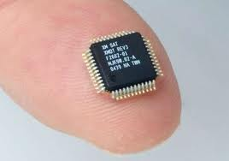
Global Semiconductor MI: Trends Technology Trends : On The Rise
Medical applications for clinical purposes- An area of focus for specific devices is a biochip to detect flu viruses. H5N1 (bird flu) and H1N1 (swine flu) versions have been produced.
Detection of food pathogens- This involves the analysis of bacterial contaminants in food and water
Chemical and biohazard analysis
Mobile device makers have experimented with the addition of biochips onto the cases of mobile phones. This could facilitate health screening services offered by mobile operators or their partners. Biometric sensing, including DNA fingerprinting is also receiving attention.
The amount of reported progress in biochips has stalled in the past year or two, caused partly by the economic downturn
Biochips
Biochips relate to a number of technologies that involve the merging of semiconductor and biological sciences. The most common form is based on an array of molecular sensors arranged on a small surface — typically referred to as "Lab-on-Chip" (LoC). The underlying mechanism utilizes microfluidic micro-electromechanical systems (MEMS) technology.
These devices are used to analyze biological elements such as DNA, ribonucleic acid and proteins, in addition to certain chemicals.
Another form of biochip is less well developed and involves the growing of biological material on silicon for implanting into the human body. The growth of neurons on silicon, for example, is a promising area for retina and hearing implants.
There could be a significant impact on healthcare if the technology achieves its promise of faster and more accurate diagnosis Gartner Rating- Benefit Rating: High ; Market Penetration: Less than 1% of target audience
Notes:
Sources:
Gartner- Hype Cycle for Semiconductors and Electronics Technologies, 2011 (Published: 25 July 2011)

Slide 40
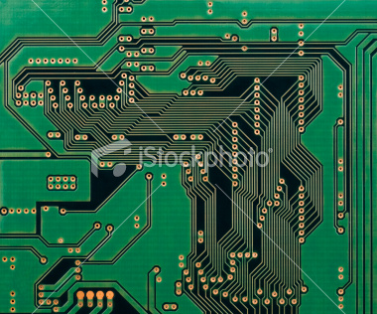
Global Semiconductor MI: Trends Technology Trends : At The Peak
GaN will form the basis of several kinds of integrated circuits in the future — notably high frequency and high power devices.
These materials are relatively expensive and the manufacturing processes are not well developed. The current focus is on specialist discrete transistors, as well as light-emitting or laser diodes.
Lighting, wireless, telecommunications and automotive are likely to be the first
significant applications.
GaN Integrated Circuits
Gallium nitride (GaN) is a semiconductor material that has high-frequency and highpower characteristics, and is capable of operating at high temperatures.
GaN is already used for specialist discrete devices, such as blue light-emitting diodes and blue laser diodes for Blu-ray disc players.
There is also a lot of interest in high-frequency uses, such as microwave power amplifiers for mobile base stations operating at frequencies above 60GHz.
GaN is relatively unaffected by ionizing radiation, making it attractive for solar cell and space/satellite applications.
Designers of high-power microwave systems would be benefitted from this technology
Gartner Rating- Benefit Rating: High ; Market Penetration: Less than 1% of target audience
Notes:
Sources:
Gartner- Hype Cycle for Semiconductors and Electronics Technologies, 2011 (Published: 25 July 2011)

Slide 41
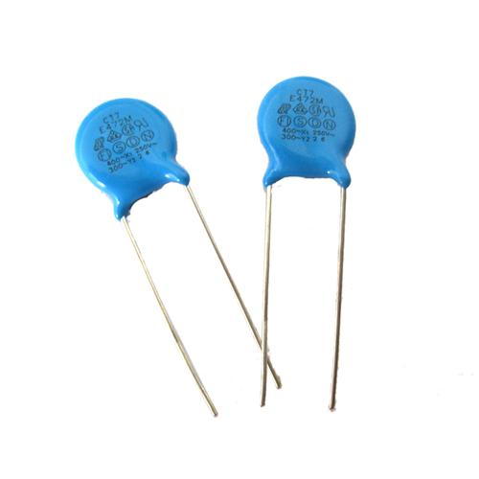
Global Semiconductor MI: Trends Technology Trends : At The Peak
Capacitor and battery manufacturers would evaluate this technology with some urgency.
Manufacturers of the systems and products mentioned above would explore the implications and uses of nanomaterial supercapacitors in their products.
The use of this technology has the potential to significantly enhance the attractiveness and usability of some product types, such as electric vehicles
Supercapacitors can also help to reduce the amount of chemicals (in batteries) that may need special consideration at the end of life.
Nanomaterial Supercapacitors
Unlike batteries, supercapacitors can be charged and discharged very quickly and can provide far higher pulses of power than can be achieved from batteries.
The ratio of energy to weight and energy to volume is also significantly better than for traditional capacitors, suggesting usage in a number of specific areas
Supercapacitors could be used for short-term power supply interruptions (such as memory backup), power boosters for fuel cells, acceleration boosters in hybrid electric vehicles, flash boosters in digital cameras and for the short-term storage of electrical energy from solar cells or other energy sources.
The use of this technology has the potential to significantly enhance the attractiveness and usability of some product types, such as electric vehicles
Gartner Rating- Benefit Rating: High ; Market Penetration: Less than 1% of target audience
Notes:
Sources:
Gartner- Hype Cycle for Semiconductors and Electronics Technologies, 2011 (Published: 25 July 2011)

Slide 42
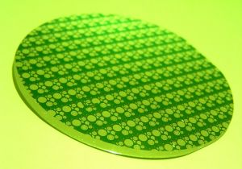
Global Semiconductor MI: Trends Technology Trends : At The Peak
Historically, moving to the next wafer size provided approximately a 30% reduction in processing cost
The key issue to moving to 450 mm will be the economics: Can the same number of wafers per hour be processed with equipment that costs no more than 1.5 times the previous generation of equipment?
The move to 450 mm will reduce costs for semiconductor manufacturers. It will mean more devices per wafer, which in turn means building fewer manufacturing facilities and hiring fewer engineers to support the manufacturing efforts.
The key will be whether the semiconductor equipment manufacturers can make a profit and get a reasonable return on their investment with fewer fabs.
450 mm Wafers
A 450-millimeter (mm)-diameter silicon wafer is the next wafer-size transition for semiconductor manufacturing.
The 450 mm wafers provide 2.25 times the area of a 300 mm wafer and thus increase the number of devices that can be processed at one time.
Depending on the device layout, 2.5 times the number of devices can be placed on a 450 mm wafer compared with a 300 mm wafer.
The semiconductor equipment vendor will adopt to the technology based on the profitability
Gartner Rating- Benefit Rating: High ; Market Penetration: 5% to 20% of target audience
Notes:
Sources:
Gartner- Hype Cycle for Semiconductors and Electronics Technologies, 2011 (Published: 25 July 2011)

Slide 43
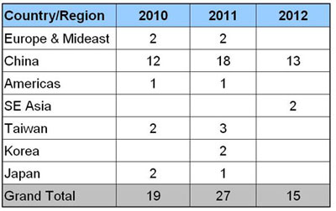
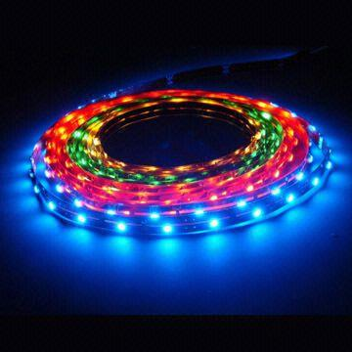
Global Semiconductor MI: Trends Technology Trends : LED Technology
LED Technology
The industry has attracted a huge amount of capital pouring into the LED supply chain from equipment and materials to LED epitaxy/chip fabrication and LED packaging capacity.
There has been an explosive growth on equipment spending from LED fabs, jumping from $606 million in 2009 to $1.78 billion in 2010.
LED equipment spending spree will continue this year and expected to reach about $2.5 billion, a 40% rise Y-o-Y.
19 new fabs that started operation in 2010 and 27 new operation fabs are expected in 2011. The geographic distribution of these new projects is mostly located in Asia, especially from China, Taiwan, and Korea.
LED Fabs Start Operation
With the wide adoption of LED technology in LCD backlight applications, the LED industry has now advanced into
the growth stage of its life cycle.
Notes:
Sources:
http://www.semi.org/node/36821

Slide 44
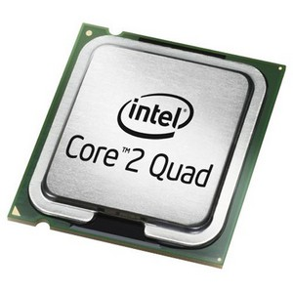
Global Semiconductor MI: Trends Technology Trends : Many-Core Processors
Many-Core
Processors
Supporting this exponentially large number of cores requires new designs for internal communication between the cores and other components, and poses major challenges for applications and operating systems to properly exploit the processing power.
Most many-core solutions use graphics processing units (GPUs), but more general-purpose compute engines will emerge supporting 32, 64, and potentially hundreds of traditional microprocessor cores during the next few years.
There is also a trend of improving energy-efficiency by focusing on performance-per-watt with advanced fine-grain or ultra fine-grain power management and dynamic voltage and frequency scaling (i.e. laptop computers and portable media players).
Many-core processors are microprocessors that typically include 16 or more processing cores in a single package, which is many more than the multicore (dual- and quadcore) processors currently standard on systems from low-end notebooks to servers.
AMD and Intel released 8 and 12- core processor chips in 2010
Many-core processors have the potential to bring high-performance computing power to PCs in the $1,000 to $1,500 range.
Notes:
Sources:
Gartner Hype Cycle for PC Technologies, July 2010

Slide 45
Global Semiconductor MI: Trends Technology Trends : Cloud Adoption
This may well be the year when more serious platforms for cloud applications make the option of moving enterprise software to the cloud an enticing alternative.
In semiconductors industry, ASIC and digital system design is a computing resource-hungry task that would certainly benefit from cloud computing. For instance, Synopsys and other EDA vendors use Amazon Web Services (AWS) to provide web-based training services. These services are Infrastructure as a Service (IaaS), i.e., it gives the customer the ability to use processing, network, and storage resources in a flexible manner
For the electronics design and semiconductor industry, uncertainty lies in the revamping of tools to fit cloud infrastructure, business model and data and IP security over cloud network.
In anticipation of this major shift, there are a few key strategies that semiconductor manufacturers and suppliers should consider implementing:
Recognize and anticipate significant changes in demand levels for enterprise computing, with cloud service providers moving into position as the dominant buyers in the marketplace for computing infrastructure.
Work with the growing needs of cloud computing service providers to adapt product requirements, and focus, in particular, on the density and high virtualization of cloud computing architectures.
Shape the product set designed for end-users and consumers around the needs for remote accessing and processing from cloud computing service providers, not intensive "end-node" computing.
Cloud Adoption:
Enterprise software
begins migrating
to the cloud
In a story published by Forbes in January 2010, Intel said that they see the move to cloud computing as "one of the biggest opportunities in computing history." They view the transition to cloud computing as a boon to potential new sales. But their future customer isn't necessarily the traditional end-user enterprise, but instead cloud computing service providers with enormous data centers with homogenous technology architectures. Of course, the downside being less demand for their long-time bread-and-butter products —servers and server chips. As demand drops, prices drop, consequently, lower the market profit levels for server chips.
With the increasing adoption of cloud computing, those semiconductor businesses that have the foresight to identify and act on
the inevitable changes coming to their industry will be better positioned to profitably meet customers' needs in the future.
Notes:
Sources:
Gartner Hype Cycle for PC Technologies, July 2010
http://www.ocoudert.com/blog/2011/03/16/cloud-computing-an-opportunity-for-eda/
http://blogs.computerworld.com/17473/ten_it_trends_to_watch_in_2011
http://www.xuropa.com/blog/2008/12/12/cloud-computing-saas-and-electronic-design-part-4/
http://www.gsaglobal.org/forum/2010/2/articles_deloitte.asp

Slide 46
Global Semiconductor MI: Trends Technology Trends : Cloud Adoption
Cloud Adoption Instances in Semiconductor Industry
Fairchild Semiconductor
Fairchild Semiconductor selected Workday to simplify and standardize core HR business processes for more than 10,000 employees and managers globally. Leveraging the power of the Workday Integration Cloud Platform, Fairchild Semiconductor executed 20 Studio integrations and eight EIBs, effectively deploying Workday HR and Workday Payroll, along with solutions for learning management, recruiting, and time tracking, across 17 countries in less than eight months. Accenture, Deloitte, and Towers Watson, three of Workday's global alliances, are now actively investing resources in the Workday Integration Cloud Platform.
"We built 28 integrations to Workday in less than 120 days." That's cloud, baby! ~ Paul Lones, CIO, Fairchild Semiconductor
Flextronics
“You're not buying $3 million worth of servers and signing a deal with a third-party integrator for $10 million. For SAP implementation you would be talking 60 people, maybe up to 100 people.“ ~ David Smoley, CIO, Flextronics
Cloud services, like the one Workday provides, let companies rent hardware and software. He's needed less than 20 people to implement Workday.
Flextronics CIO David Smoley is quickly running a SaaS shop and counts Workday, Salesforce.com and Service-now.com as three go-to providers. The company uses Salesforce.com as the standard for customer relationship management software, Workday for human resources and Service-now.com for service tickets. The latter service consolidated three ticket systems. The plan is to work in SaaS opportunistically as older systems are retired.
Notes:
Sources:
http://www.zdnet.com/blog/gardner/case-study-how-fairchild-semiconductor-leverages-the-workday-integration-cloud/4150
http://www.zdnet.com/blog/btl/cio-in-the-cloud-7-saas-questions-with-flextronics-david-smoley/33756

Slide 47

Global Semiconductor MI: Trends Technology Trends : Automotive Semiconductors
Automotive
Semiconductors
Increased production of hybrid electric and battery electric vehicles is forecast to offer substantial new revenue opportunities for semiconductor suppliers, with production of hybrid vehicles forecast to rise from three million in 2010 to 47 million in 2017.
Demand for power semiconductors is forecast to rise strongly due to the increased demand of hybrid and electric vehicles, benefitting specialist power semiconductor suppliers like Infineon Technologies and ST Microelectronics.
China remains one of the most significant growth drivers of the automotive sector, with light vehicle production in China totaling almost 15 million in 2010, double the level of 2008.
2010 was a strong year for the automotive semiconductor market, with sales increasing by nearly 37%. Automotive semiconductor sales have touched record levels and growth is set to continue, with sales of automotive semiconductors forecast to total USD 39 billion in 2017.
2010 was one of the strongest year for the automotive semiconductor market, with sales increasing by nearly 37%.
Notes:
Sources:
IDC
http://www.businesswire.com/news/home/20110419007283/en/Worldwide-Semiconductor-Market-Grew-24-2010-283
http://www.ecnmag.com/News/2011/03/Industry-News/Automotive-Semiconductor-Market-Grew-by-37-per-cent-in-2010/

Slide 48
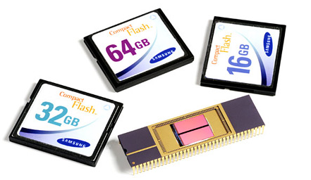
Global Semiconductor MI: Trends Technology Trends : DRAM & NAND Flash Memory
DRAM & NAND
NAND flash has received a major boost from demand from the smartphone and tablet markets.
Another new trend that could drive up demand is laptops based on NAND flash memory. Apple’s MacBook Air is based on it and could lead the way for increased use of flash in laptops.
Samsung and Toshiba/SanDisk are believed to be Flash suppliers for the MacBook Air.
Samsung and Toshiba are the leading suppliers of NAND Flash and are the main suppliers to Apple products like iPhone and iPad, while Micron is the third-largest supplier.
Global DRAM and NAND flash memory market segments achieved 80% and 40% growth in 2010, respectively, leading the industry boom.
Semiconductor revenue in 2010 achieved record growth of 32.5% to reach $304 billion, courtesy of a boom in DRAM and NAND sales.
In 2010, stabilizing DRAM prices led to a direct impact on PC desktop and notebook prices.
Notes:
Sources:
http://www.eeherald.com/section/news/nws201012226.html
iSuppli - http://www.isuppli.com/semiconductor-value-chain/news/pages/semiconductor-revenue-expands-by-record-margin-in-2010.aspx

Slide 49

Global Semiconductor MI: Trends Technology Trends : Solar Energy
Solar Energy
Due to depletion of the traditional energy sources and environmental impact of these fossil fuel energy sources, there is intense interest in renewable forms of energy generation. Governments in many parts of the world are promoting the adoption of renewable sources, notably solar energy.
Enterprises are being encouraged by a combination of pressure from customers & other stakeholders, and government incentives.
Solar energy and solar cells utilize semiconductors to produce energy and hence increase in use of solar energy would ultimately benefit and add to the opportunities for the semiconductor industry.
Silicon is the industry standard semiconductor in most electronic devices, including the photovoltaic cells that solar panels use to convert sunlight into energy
Solar power will be an important enabler of sustainability strategies by enterprises and power purchase agreements in North America and
feed-in tariffs in Europe will be central to these incentives.
Notes:
Sources:
http://www.eeherald.com/section/news/nws201012226.html
iSuppli - http://www.isuppli.com/semiconductor-value-chain/news/pages/semiconductor-revenue-expands-by-record-margin-in-2010.aspx
http://www.echannelline.com/usa/story.cfm?item=26106

Slide 50
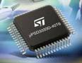
Global Semiconductor MI: Trends Technology Trends : System-on-chip
SOC
Impact of recession on SoC market has been largely short-lived when compared to the impact on other chip technologies, largely because the underlying economics of packaging greater functionalities into smaller and yet more power-efficient devices, continue to drive the need for greater integration within a semiconductor device, which in turn accelerates the demand for SoCs.
Renewed emphasis on tapping into growth opportunities in the chip industry will elicit a shift in focus away from cost reduction towards technology innovation, with ensuing benefits echoing downstream into the SoC segment.
Growing popularity of virtualization, cloud computing, and increased penetration of mobile computing platforms, will drive increased adoption of SoCs in the computing end-use sector.
SoCs are expected to emerge into a pivotal technology, which will find increased adoption for advanced computers, smartphones, and other mobile devices and handsets, new-age consumer electronic devices and automotive electronics among others.
Notes:
Sources:
http://www.pr-inside.com/system-on-a-chip-soc-a-global-strategic-r2507154.htm

Slide 51
Global Semiconductor MI
Market Overview
Competitive Landscape
Contract Analysis
Business Trends
Semiconductor Industry Growth Drivers & Inhibitors
Technology Trends
Effect of the Japanese Crisis on the Semiconductor Industry
Market Drivers
Key IT Drivers in the Semiconductor Industry
Top 3 Market Players
Few IT Implementation Examples in the Semiconductor Industry
Disclaimer:
The information presented in this report is based on data available in the public domain. If you find that it is incorrect, please let us know.

Slide 52


Global Semiconductor MI: Market Drivers Semiconductor Industry Growth Drivers & Inhibitors
Growth Drivers
Growth Inhibitors
Complex SoCs
FPGA devices
Specialty silicon used in smartphones and connected home entertainment markets
Growth in the security chip space due to security requirements and awareness
Boom in DRAM and NAND sales due to demand from DRAM & NAND flash market
Renewed demand for electronic equipment, such as computers, televisions and cell phones.
Inventory rebuilding (due to the slag caused in 2009)
Upward price pressure due to a supply/demand imbalance
Increase in the average semiconductor content of major electronic products
Increased use of ‘Solar Energy’ can boost sales for semiconductors
Mobile Phones and Tablets Spur Modest Upgrade in 2012 Chip Industry
Silicon shortage in semiconductor industry due to the disaster in Japan
Slowed operations in Japanese semiconductor wafer fabs can lead to a foundry wafer pricing increase in the near term.
Slowdown in global economic recovery
Instability/uncertainty in the demand of consumer electronics goods
DRAM downturn expected in 2011 and 2012
Decline in semiconductor demand due to slowdown in PC sales
Counterfeit Parts
Notes:
Sources:
Gartner Report: Foundries Can Stem Semiconductor Production Losses by Japanese Vendors, March 2011
Gartner Report: Disasters in Japan Make Semiconductor Industry Face Silicon Shortage, March 2011
http://www.eetimes.com/electronics-blogs/semi-conscious/4211463/What-s-your-forecast-for-the-2011-semiconductor-market-?pageNumber=0
http://www.isuppli.com/semiconductor-value-chain/news/pages/semiconductor-revenue-expands-by-record-margin-in-2010.aspx
http://www.isuppli.com/Semiconductor-Value-Chain/News/Pages/Mobile-Phones-and-Tablets-Spur-Modest-Upgrade-in-2012-Chip-Industry-Growth-Forecast.aspx

Slide 53
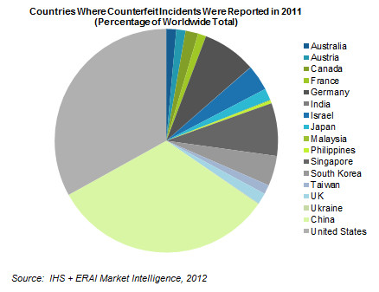
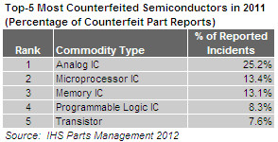
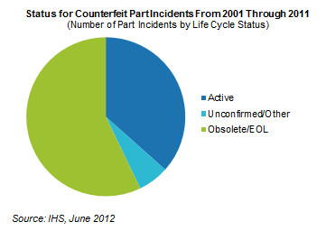
Global Semiconductor MI: Market Drivers Concern over Counterfeit Parts
More than 12 million parts have been involved in counterfeit incidents during the period spanning the start of 2007 through April 2012, according to Rory King, director, supply chain product marketing at HIS
Reported incidents of counterfeited parts amounted to 1,363 in 2011. However, each incident can include thousands of separate parts, adding up to 12 million over the past five-and-one-quarter years. This equates to slightly more than 1 counterfeit part every 15 seconds.
The five most prevalent types of semiconductors reported as counterfeits that have widespread commercial and military use represent $169 billion in potential annual risk for the global electronics supply chain, according to information and analytics provider IHS
Obsolete Parts: The Hidden Counterfeit Challenge- Obsolete parts are where a lot of counterfeit activity is occurring. This underscores the importance of obsolescence management and lifecycle planning. Although obsolescence management is critical, more than one-third of counterfeit incidents are for active components underscoring that this issue is not exclusively a matter of obsolescence management.
Defense Against Counterfeit- The U.S. National Defense Authorization Act (NDAA), which was signed into law on Dec. 31, imposes strict regulations and severe criminal penalties on counterfeits supplied for government military and aerospace programs.
Notes:
Sources:
http://www.isuppli.com/Semiconductor-Value-Chain/News/Pages/One-Counterfeit-Part-Every-15-Seconds.aspx
http://www.isuppli.com/Semiconductor-Value-Chain/News/Pages/One-of-Every-Two-Counterfeit-PartsisObsolete%E2%80%94But-Managing-Obsolescence-is-Not-Enough.aspx
http://www.isuppli.com/Semiconductor-Value-Chain/News/Pages/Top-5-Most-Counterfeited-Parts-Represent-a-$169-Billion-Potential-Challenge-for-Global-Semiconductor-Market.aspx

Slide 54
Global Semiconductor MI: Market Drivers Key IT Drivers in the Semiconductor Industry
Cloud Adoption: In semiconductors industry, ASIC and digital system design is a computing resource-hungry task that would certainly benefit from cloud computing. For instance, Synopsys and other EDA vendors use Amazon Web Services (AWS) to provide web-based training services. These services are Infrastructure as a Service (IaaS), i.e., it gives the customer the ability to use processing, network, and storage resources in a flexible manner
e-diagnostics: E-diagnostics offers businesses the promise of better equipment reliability and performance at cheaper cost. Semiconductor and semiconductor equipment manufacturers have begun pointing the way for other industries by embracing e-diagnostics as a way to improve supply chain costs and responsiveness. In doing so, they're improving customer service as measured by overall equipment efficiency and cost of ownership -- key industry indicators for equipment performance
Automation of supply chain: There is an inherent desire among the semiconductor manufacturers to automate basic supply chain planning and execution processes. With increased process automation and standardization supply chain planners can focus their efforts on managing “exceptions” and maintaining and updating the planning models as opposed to spending their time doing “manual reconciliations”.
External Supply Chain Collaboration: Since semiconductor companies rely on a combination of outsourced manufacturing partners, hence improving external supply chain collaboration is also a wide spread initiative (tracking WIP status through foundry, assembly and test process, operational yield/cost tracking, etc.). Having real-time visibility into manufacturing and back-end operations can help mitigate order delivery or supply disruption issues before they become large enough to affect quarterly financial targets.
Demand Forecast: Companies are also working on capabilities that can automate the process of converting the unconstrained demand forecast and create a “capacity-constrained” supply chain plan across foundry, assembly and test vendors. Having this capability allows planners to systematically balance or allocate stead-state demand based on back-end capacity constraints, while focusing their efforts on in-quarter customer order (upside requests, product mix change, etc.).
Inventory Management: In order to improve inventory performance, reduce inventory cost and improve customer service levels, companies are working on efforts to increase inventory visibility across the extended supply chain including die banks, assembly/test facility, distribution center and Vendor Managed Inventory (VMI) hubs.
Effective Planning through IT: Semiconductor manufacturers are also attempting to reduce demand-supply planning cycle times and improving planning frequency. Fast, frequent planning cycles reduce the negative impact of demand-supply mismatch.
Notes:
Sources:
http://www.gsaglobal.org/documents/2010/Supply_Chain_Oracle.pdf
http://www.eetimes.com/electronics-news/4215239/A-wakeup-call-for-the-global-semiconductor-supply-chain

Slide 55
Global Semiconductor MI: Market Drivers Key IT Drivers in the Semiconductor Industry
Product Lifecycle Management
83% of issues identified during validation are design related
Only 45% of new product launch meet their original launch date
Only 59% of all semiconductor designs make it into production
Over 40% of development projects exceed the planned budget
More than 60% of all semiconductor designs require at least one re spin
Chip densities for digital and memory ICs have continuing to go down from 90 nm to 65 nm to currently 45 nm. The companies are currently investing in the 22 nm technology.
Today a design flaw undetected until tape out could mean millions of loss to the company.
As the semiconductor industry continues to evolve and the competition intensifies, semiconductor companies would need strong execution to meet the stringent time cycle for product development
PLM would become a more important solution to not only fight with the rising cost in the industry, but also maintain the target of a new product development
Notes:
Sources:
http://www.product-lifecycle-management.info/white-papers/kalypso/PLM-White-Paper-Kalypso-Semiconductor-Product-Lifecycle-Management.pdf

Slide 56
Global Semiconductor MI: Market Drivers Key IT Drivers in the Semiconductor Industry
Obsolescence Management
Counterfeit risk lies mainly in the obsolete parts
$169 bn potential loss for global market by top 5 counterfeits parts
Incidents of counterfeit parts have tripled during the past two years
U.S. & China combined reported 65% of total counterfeits incidents
One counterfeit part incident in every 15 seconds
Slightly more than one out of every two counterfeit parts shipped during the decade from 2001 to 2011 are obsolete
There has been a great deal of focus on the issue of counterfeit parts in the defense industry, but the majority of reported counterfeit incidents are for commercial components which have broad use across both military and commercial applications
U.S. has already taken strong regulations for counterfeit part detection and avoidance
Obsolete parts are where a lot of counterfeit activity is occurring. This underscores the importance of obsolescence management and lifecycle planning. To protect the brand image from counterfeits and inferior parts, obsolescence management will become more important in this industry
Notes:
Sources:
http://www.isuppli.com/Semiconductor-Value-Chain/News/Pages/Top-5-Most-Counterfeited-Parts-Represent-a-$169-Billion-Potential-Challenge-for-Global-Semiconductor-Market.aspx
http://www.isuppli.com/Semiconductor-Value-Chain/News/Pages/One-Counterfeit-Part-Every-15-Seconds.aspx

Slide 57
Global Semiconductor MI: Market Drivers Key IT Drivers in the Semiconductor Industry
Cloud Computing
With the current ongoing financial pressure, organizations are compelled to reduce operational costs and streamline their efficiency. Responding to these more and more companies would like to move their data in cloud environment
In semiconductors industry, ASIC and digital system design is a computing resource-hungry task that would certainly benefit from cloud computing. For instance, Synopsys and other EDA vendors use Amazon Web Services (AWS) to provide web-based training services. These services are Infrastructure as a Service (IaaS), i.e., it gives the customer the ability to use processing, network, and storage resources in a flexible manner
The future-
Companies still not willing to take the risk of moving their sensitive data on cloud.
More and more ECM vendors are providing cloud alternatives for deploying content management
Market demand for these cloud solutions, whether as software as a service (SaaS)or dedicated solutions, continues to grow as they become more cost competitive and address security and privacy concerns
More and more companies will embrace the Cloud as it becomes more cost competitive and address security and privacy concerns
Notes:
Sources:

Slide 58
Global Semiconductor MI: Market Drivers Key IT Drivers in the Semiconductor Industry
Supply Chain Management
Wafers are lead time intensive products and therefore sensitive of the supply chain and availability of the finished goods are largely dependent on advanced planning
The main performance measure of the semiconductor supply chain is dependable demand, resource utilization, process yield management, throughput time of wafers, collaboration with contract manufacturing
This new business normal – characterized by extremely volatile demand, global shortage of manufacturing capacity, growing lead times and scarce supply – is straining and challenging semiconductor supply chains like never before
Seamless integration between the OEM and contract manufacturer is another important aspect of the semiconductor supply chain
The future-
Need of accuracy in demand forecasting- The industry is seeing a sudden rise in demand. But with the volatile economy the demand is expected to be volatile also. Too much of production will leave the companies with too many inventories to handle with; where as too less production will cause to loss the market share to competitors
Capacity utilization- Too little capacity threatens customer service levels and too much can erode profit margins
Enhance the logistic and transportation management
Optimize the inventory management process
The volatile economy indicates volatile demand which will require much more advanced demand forecasting, and to serve the sudden demand from the customers, the market players will seek more efficient SCM solution
Notes:
Sources:
http://www.infosys.com/industries/high-technology/white-papers/Documents/supply-chain-planning-semiconductor.pdf
http://www.jda.com/file_bin/brochures/jda-high-tech-semiconductor_industry-brochure.pdf

Slide 59
Global Semiconductor MI: Market Drivers Few IT Implementation Examples in the Semiconductor Industry
AMD Corporation
“
In 2012 AMD has selected HP for the cloud data center implementation. With 18 data centers worldwide, AMD recognized the need to consolidate its infrastructure to optimize resources as well as improve power and cooling efficiency. The HP 12500 Switch Series and HP 5820 Switch Series will be used in AMD’s newest private cloud data center, where the company makes heavy use of virtualization and cluster technologies. Implementing HP Networking and server technologies helped AMD reduce its data-center footprint by more than 50%while increasing network capacity and improving performance.
We were experiencing suboptimal business operations due to infrastructure sprawl. HP Networking’s open, standards-based architecture offered us the flexibility to easily integrate solutions and expand our infrastructure while leveraging existing investments
”
Farid Dana
Director, IT, Global Infrastructure Services, AMD
Hynix Semiconductor
“
Hynix Semiconductor, the world's second largest memory chip maker, has deployed a high-performance switching infrastructure running on the Junos® operating system at its research and development (R&D) center. The new Juniper Networks® EX Series Ethernet Switches will help the company speed up its R&D processes and deliver greater innovation to the mobile devices sector.
Through our new network strategy for the enterprise, Juniper embodies the practice of reducing complexity and maximizing economics for our customers. Hynix’s success will serve as a strong role model for other companies looking to boost performance by leveraging next-generation network technology.
”
Tim Kang
Vice President, Juniper Network Korea
Maxim Integrated Products
“
Maxim Integrated moved more of its legacy systems into the Salesforce Cloud / Platform. It was able to accomplish all the integrations with Salesforce using Salesforce.com’s API and PHP.
That's the great thing about the Force.com community: everybody is willing to help. If you ask a question on the development forum, you usually get a response within 24 hours
”
Michael Symonds
Developer & Analyst, Maxim
Notes:
Sources:
http://www.hp.com/hpinfo/newsroom/press/2012/120425a.html
http://www.juniper.net/au/en/company/press-center/press-releases/2011/pr_2011_10_06-14_54.html

Slide 60
Global Semiconductor MI: Market Drivers Few IT Implementation Examples in the Semiconductor Industry
Renesas Technology Corporation
Renesas has established a dedicated ODC at KPIT Cummins to strengthen its development and design capabilities. Mainly to outsource design work for developing sophisticated multi-function System-on-Chips (SoCs) with a high level of design capability. In November 2004, Renesas started outsourcing semiconductor software and hardware design to KPIT Cummins. Since then, KPIT Cummins has executed design work for Renesas in a number of areas, including SoC products for use in digital consumer electronics, analog circuit designs employing high- level technology, and embedded software.
“
With this ODC we will be securing the services of a team of excellent engineers and improving the design setting in which they work. In addition, we are making it possible for KPIT to perform strategic, high-quality hardware and software design work for Renesas in a secure environment
”
Atsushi Asari
Board Director, Renesas Technology
Fairchild Semiconductor
Fairchild has worked with IBM and with i2, an IBM strategic alliance partner, to develop and deploy a comprehensive solution for supply chain management. Advanced Planning Solution (APS) initiative centralized Fairchild’s planning and forecasting organized as a cross functional enterprise wide effort.
Fairchild implemented JDA® Order Promiser and JDA® Supply Chain Planner. The solutions help companies to respond to demand variability, to profitably manage their supply and to satisfy their customers better than the competition. Fairchild is using JDA solutions to normalize its business processes, to identify and satisfy customer demand, to reduce inventory and to improve its turn business.
“
There is absolute alignment between S&OP forecasts and other high level plans and what happens in downstream fabs and assembly operations, to the point where customer priorities and service policy segmentations at higher levels of the company's planning are exactly reflected in Fairchild's detailed manufacturing plan
”
Kevin Chynoweth
Supply Chain Head, Fairchild Semiconductor
Notes:
Sources:
http://www.jda.com/file_bin/casestudies/Fairchild-Semiconductor_JDA-case-study.pdf
http://www.salesforce.com/platform/success_stories/stories/maxim.jsp

Slide 61
Global Semiconductor MI
Market Overview
Competitive Landscape
Contract Analysis
Business Trends
Technology Trends
Intel
Market Drivers
Texas Instruments
Top 3 Market Players
TSMC
Disclaimer:
The information presented in this report is based on data available in the public domain. If you find that it is incorrect, please let us know.

Slide 62
Global Semiconductor MI: Top 3 Market Players Intel
Intel Corporation (Intel) is a US based semiconductor chip manufacturer
Incorporated in 1968, Intel designs and manufactures integrated digital technology platforms
The Company sells these platforms primarily to original equipment manufacturers (OEMs), original design manufacturers (ODMs), and industrial and communications equipment manufacturers in the computing and communications industries
It operates across North America, Latin America, Asia Pacific, Europe, Middle East and Africa.
Company Profile
Intel has attained its highest annual market share in more than 10 years, according to a report from information and analytics provider IHS iSuppli.
Intel increased its overall semiconductor market share to 15.6% in 2011 – a year on year increase of 2.5%.
The company's rise was spurred by soaring demand for its pc oriented microprocessors and for its NAND flash memory used in consumer and wireless products
The company's strong rise helped it to stave off the rising challenge mounted by number two semiconductor supplier Samsung Electronics, which had been whittling away at Intel's lead in recent years
Recent Acquistion- In last two years Intel has gone through some strategic mergers and acquisition which have helped them to retain the top spot and get the highest market share in the industry in last 10 years- Qlogic, RealNetworks, Olawork Inc, Telmap Ltd, Nitro Security Inc, Siport Inc, Sentrigo Inc, McAfee Inc, Infineon tech
Expansion- Intel will build a new microprocessor factory at Chandler, Arizona, which is expected to be completed in 2013, at a cost of $5 billion. It will accommodate 4,000 employees
Recent Development
Notes:
Sources:
OneSource
Wikipedia
http://www.newelectronics.co.uk/electronics-news/intel-semiconductor-market-share-reaches-10-year-high/41244/
http://www.alacrastore.com/mergers-acquisitions/Intel_Corporation-503434

Slide 63
Global Semiconductor MI: Top 3 Market Players Intel
Intel in 2011 saw its revenue jump by 23.7%. This outpaced every other semiconductor supplier in the Top 20 with the exception of Qualcomm and ON Semiconductor, both of which also saw exceptionally high levels of growth based on a combination of organic expansion and key acquisitions.
Return on Sales for the last two years (2010 and 2011) have been the highest in the last decade
Notes:
Sources:
OneSource
http://www.newelectronics.co.uk/electronics-news/intel-semiconductor-market-share-reaches-10-year-high/41244/

Slide 64
Global Semiconductor MI: Top 3 Market Players Texas Instruments
Texas Instruments Inc. (TI) designs and makes semiconductors, which it sells to electronics designers and manufacturers globally.
The Company has design, manufacturing or sales operations in more than 35 countries.
The Company operates in four segments: Analog, Embedded Processing, Wireless and Other.
The Company sells custom and catalog semiconductor products. Custom products are designed for a specific customer for a specific application, are sold only to that customer and are sold to the customer.
Company Profile
Recent Acquisition- National Semiconductor, the acquisition made Texas Instruments the world's third largest semiconductor company.
The acquisition also expanded Texas Instruments' leadership in the global market for analog integrated circuits.
Recent Development
Notes:
Sources:
OneSource
http://www.isuppli.com/Semiconductor-Value-Chain/News/Pages/IHS-iSuppli-News-Flash-Covering-Texas-Instruments-Acquisition-of-National-Semiconductor.aspx

Slide 65
Global Semiconductor MI: Top 3 Market Players Texas Instruments
The return on sales figure is lowest compared to the top 3 players
For all of the Top 3 industry players the Return on Sales had improved remarkably in 2010 then it dropped in 2011, but maintained higher retun on sales than the 2008-2009 figure
Notes:
Sources:
OneSource

Slide 66
Global Semiconductor MI: Top 3 Market Players TSMC
Taiwan Semiconductor Manufacturing Co., Ltd. is a Taiwan-based company principally engaged in the research, development, manufacture and distribution of integrated circuit (IC) related products
The Company operates its businesses through wafer manufacture, mask production, wafer testing and packaging components
The Company also involves in the provision of production management, customer services and design services
Custoemrs- semiconductor companies, ranging from fabless semiconductor and systems companies, such as Advanced Micro Devices, Inc., Altera Corporation, Broadcom Corporation, Marvell Semiconductor Inc., MediaTek Inc., nVidia Corporation and Qualcomm Incorporated, to integrated device manufacturers, such as LSI Corporation, STMicroelectronics and Texas Instruments Inc. Fabless semiconductor and system companies accounted for approximately 80%, and integrated device manufacturers accounted for approximately 20% of its net sales as of December 31, 2009.
Company Profile
May, 2012- Taiwan Semiconductor Manufacturing Co., Ltd. (TSMC) and Renesas Electronics Corp agreed to extend their microcontroller (MCU) technology collaboration to 40 nanometer (nm) embedded flash (eFlash) process technology for manufacturing MCU products used in automotive and consumer applications such as home appliances.
Recent Development
Notes:
Sources:
OneSource

Slide 67
Global Semiconductor MI: Top 3 Market Players TSMC
The return on sales of TSMC is best among all the top 3 players
In 2010 the total revenue growth was record high of 48.74% and in 2010 the total revenue was $13319 million
Notes:
Sources:
OneSource

Slide 68

For any feedback/ suggestions/ comments/ clarification please contact
aditi.royghatak@tcs.com
swati.malaker@tcs.com
Visit us on Knowmax at:
https://knowmax.ultimatix.net/sites/mrkt-corpfn/mrktint/default.aspx

